Slide 2
BTP Free Tier vs BTP Trial ( when to use what )
https://help.sap.com/docs/btp/sap-business-technology-platform/trial-accounts-and-free-tier?locale=en-US#trial-account-or-free-tier-offering:-when-to-use-which?

Slide 3
How to register Free Tier
https://developers.sap.com/tutorials/btp-free-tier-account.html

Slide 4
BTP Trial Account Tutorial
https://developers.sap.com/tutorials/hcp-create-trial-account.html

Slide 5
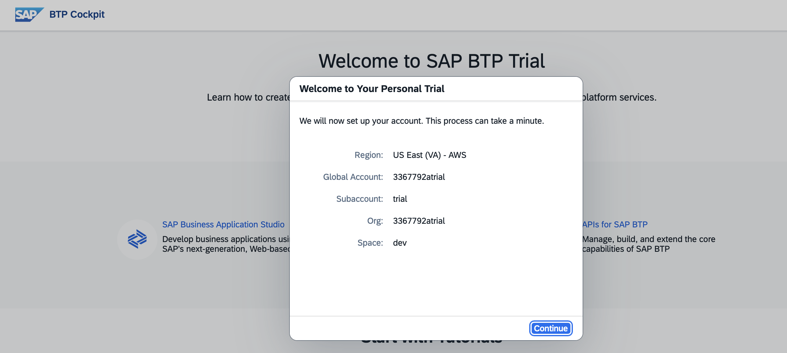
BTP Trial Account

Slide 6
Jargons and Meaning
Region
Global Account
Sub Account
Org
Space

Slide 7
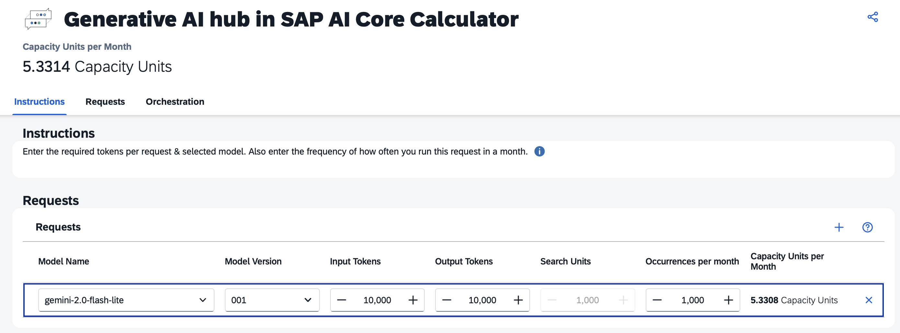
Check Prices in Discovery Center
For Eg if you want to see AI services
https://discovery-center.cloud.sap/viewServices?solution=ai
You can even calculate the cost of using various models
https://ai-core-calculator.cfapps.eu10.hana.ondemand.com/uimodule/index.html

Slide 8
End to End Tutorial
https://developers.sap.com/mission.ai-core.html
Generative AI with SAP AI Core

Slide 9
RAP
Get to know the RAP Model
https://developers.sap.com/tutorials/abap-environment-restful-programming-model.html

